Slide 1
Hormones as chemical messengers
Year 11 Biology
Bremer SHS

Slide 2
Warm-up questions
List the organs involved in excretion of wastes.
Compare cellular respiration and photosynthesis.
Outline the role of the following parts of a neuron.
Cell body
Dendrite
Synapse
Axon
Extension – may require research!
Outline the role of the lymphatic system.
Name the four main components of blood and outline their roles.

Slide 3
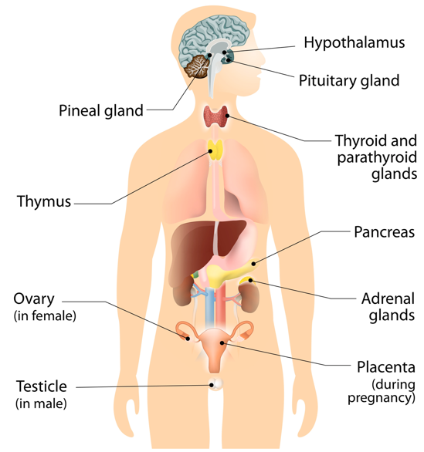
Hormones as chemical messengers
Hormones are chemicals that are produced by the body to prompt a response from specific cells.
Hormones are secreted in to the blood and lymph by organs called glands.
The endocrine system contains all of the glands that produce hormones.
The pituitary gland is known as the master gland because it produces many hormones that affect hormone production of other endocrine glands.

Slide 4
Examples of hormones
Gland | Hormone Secreted | Target Tissue | Homeostatic Response
Adrenal | Adrenaline | Liver | Stimulates release of glucose for ‘fight or flight’ response.
Adrenal | Cortisol | Many tissues | Prevents excessive autoimmune response.
Thyroid | Thyroxine | All tissues | Increases metabolism.
Pancreas | Insulin | All tissues | Stimulates the uptake of blood glucose.
Pancreas | Glucagon | Liver | Stimulates the conversion of glycogen to glucose.
Ovaries | Estrogen | Uterus | Produces an environment suitable for the fertilization and implantation of embryo.

Slide 5
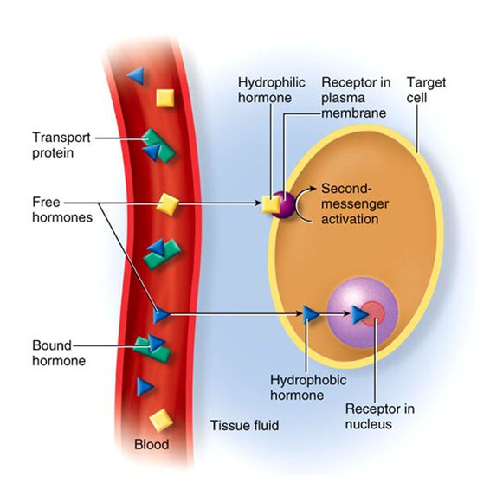
Types of hormones
Water soluble hormones (hydrophilic hormones) are derived from amino acids.
Water soluble hormones cannot pass through a cell membrane without assistance and usually bind to receptors on the outside of the target cell.
Fat soluble hormones (hydrophobic hormones or steroids) are derived from cholesterol and usually require a companion molecule to travel through the blood.
Fat soluble hormones can pass through the cell membrane of a target cell by themselves and bind to receptors once inside the cell.

Slide 6
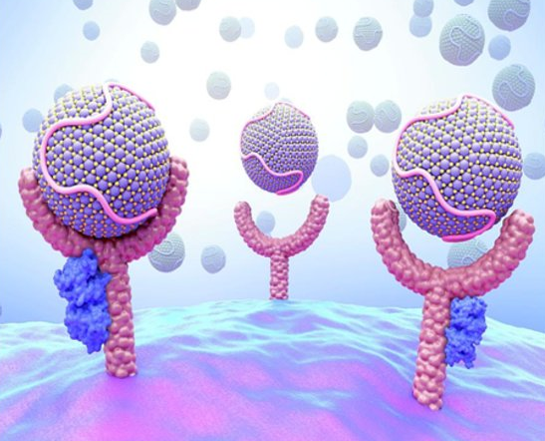
Targeting specific cells
Cells have many receptors present in their cell membranes.
The types of receptors present is dependent on the function of the cell.
Only cells in the body that have receptors for a particular hormone will respond to it.
If the cell does not have a receptor for the hormone, it will drift past the cell without any effect.

Slide 7
Conditions associated with hormones
Copy and complete the following table in to your notebook.
Hormone | Elevated Levels | Low Levels
Thyroxine | Name of condition Symptoms | Name of condition Symptoms
Cortisol | Name of condition Symptoms | Name of condition Symptoms
Insulin | Name of condition Symptoms | Name of condition Symptoms
Testosterone | Name of condition Symptoms | Name of condition Symptoms
Oestrogen | Name of condition Symptoms | Name of condition Symptoms

Slide 8

Check for understanding
Complete Biozone worksheet comparing the nervous and endocrine systems.

